Slide 1
Monitoring and Diagnostics
Notes:
Abstract:
Application monitoring and diagnosing problems is a core function of all IT groups, regardless of whether the application is running on-premises or in the cloud. In this session see how IT can leverage features such as Operational Insights to collect, store, and analyze diagnostics data. Next, learn how developers can use Application Insights to provide deep analytical metrics from their applications to improve performance, response times, analyze application failures, and discover usability trends. Lastly, learn practices for storing log data, tools for analysis, and how to configure rules and alerts to help thwart off potential problems for your end-users.
http://blogs.msdn.com/b/vijaysk/archive/2012/10/27/tools-to-simulate-cpu-memory-disk-load.aspx

Slide 2
If you can't measure something, you can't understand it. If you can't understand it, you can't control it. If you can't control it, you can't improve it. H. James Harrington
Notes:
Modern workloads and applications tap into a variety of services, and are often spread across on-premises servers and the public cloud. Monitoring these environments is a change from traditional systems. With all of the data being generated by our systems, how do we get our arms around what is happening? How do we leverage that data to make better informed decisions? How can we better understand? This is where monitoring and diagnostics techniques can help you to understand and support the users of your systems, and empower them to work more efficiently.

Slide 3
Agenda
Out of the box capabilities
Monitoring from the outside in
Understanding applications from the inside out
Notes:
Azure offerings a variety of features to monitor and support its services. We will begin with those out of the box features, and move to more sophisticated services, such as Operational Insights for monitoring environment and Application Insights for unlocking what’s happening inside of your applications.

Slide 4
Out of the box capabilities

Slide 5
Service metrics
All Azure services track key metrics for monitoring health, performance, and availability
Can be viewed in the portal or via REST API
Toggle on diagnostics for some services
Configurable via ARM
Notes:
https://azure.microsoft.com/en-us/documentation/articles/insights-service-health/
http://azure.microsoft.com/en-us/documentation/articles/insights-receive-alert-notifications/
https://azure.microsoft.com/en-us/documentation/articles/insights-how-to-customize-monitoring/
All Azure services track key metrics that allow you to monitor the health, performance, availability and usage of your services. In the Azure Portal, you can configure rich, frequent, monitoring and diagnostics data about your resources. You can also use the REST API or .NET SDK to configure diagnostics programmatically.
Diagnostics, monitoring and metric data in Azure is saved into a Storage account of your choice. This allows you to use whatever tooling you want to read the data, from a storage explorer, to Power BI to third-party tooling.

Slide 6
Out of the box service monitoring

Slide 7
Monitoring from the outside in
Notes:
What is Operational Insights? Microsoft Azure Operational Insights (https://preview.opinsights.azure.com) is an analysis service that enables IT administrators to gain deep insight into their environments. Operational Insights enables users to interact with real-time and historical computer data to rapidly develop custom insights, and provides Microsoft and community-developed patterns for analyzing data.
Operational Insights provides powerful search capabilities that enable ad-hoc root cause analysis and automated troubleshooting across multiple data sources. Without instrumenting any code directly or having knowledge of any complex schema, IT admins can quickly receive interactive results. Operational Insights search helps users drill deeper into areas of interest that are highlighted by intelligence packs. Search also enables users to form their own hypotheses and query the data to find custom insights through proactive exploration or reactive troubleshooting.

Slide 8
Monitoring with Operational Insights

Slide 9
Operational Insights
Single pane of glass for monitoring VMs
Big data solution for logs
Interact with log data via Search and Solutions
Customizable dashboards
Near real time log monitoring

Slide 10

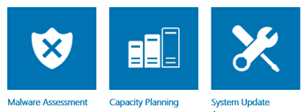
Operational Insights
Gather raw machine data
Apply logic, visualization and data acquisition rules
Provide Assessments Recommendations, Forecast, Trends
Explore Data from the Portal
Machine Data
Solution Packs

Slide 11
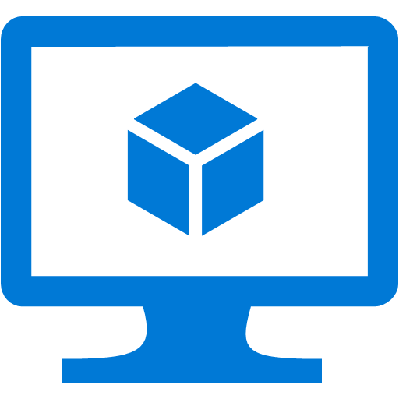



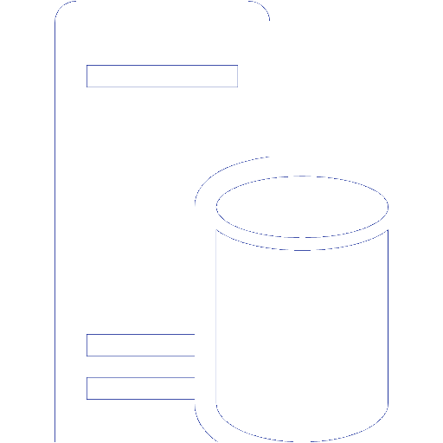
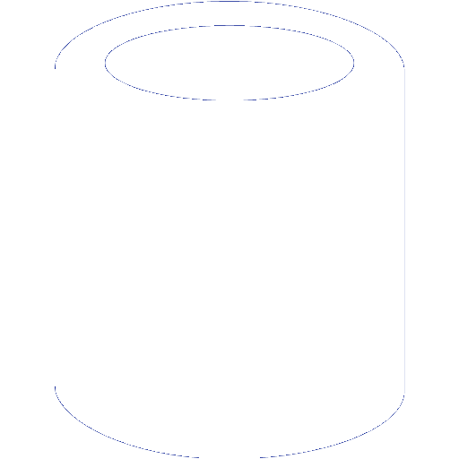
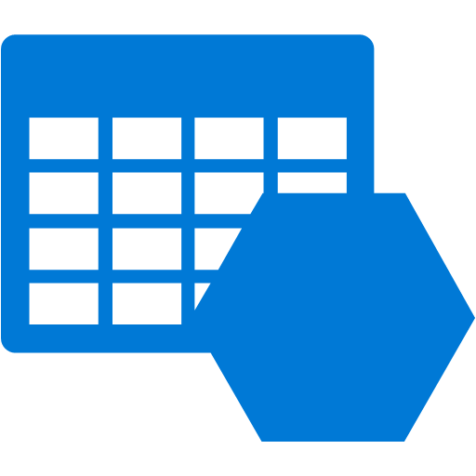


Operational Insights Architecture
OMS Workspace
VM with Agent
Azure VM with Agent
Other Clouds
OMS Service
VM with Agent
SCOM Management Server
Blob Storage
OMS Repository
VM with Agent
Clients
On Premises
Azure
Notes:
This diagram shows how data flows from your on-premises infrastructure to Operational Insights.
On the left is on-premises infrastructure, and on the right is the Operational Insights service. Data is collected in 3 ways: from management groups, from utilizing existing SCOM agents, or by installing a dedicated Ops Insights agent. Data being sent to the service bypasses on premises databases, thus not adding additional load or overhead to those servers. Notice the arrows in the diagram all go from on premises to the cloud; there is no need to open any inbound firewall ports on your on premises environment.
Once data is ready it is compressed, encrypted and transferred to Ops Insights. Compression minimizes network load, and encryption is done both at the file level and the connection itself for double encryption.
Data from each customer is stored in a separate, physical file within the service and is not co-mingled with other customer data. Data is accessed via the web portal.

Slide 12
Searching through data
Command syntax heavily influenced by PowerShell
Fast performance against millions of records
Easily export search results to CSV/Excel
Notes:
https://azure.microsoft.com/en-us/documentation/articles/operational-insights-search/
At the core of Microsoft Azure Operational Insights is the log search feature which allows you to combine and correlate any machine data from multiple sources within your environment. Solutions are also powered by log search to bring you metrics pivoted around a particular problem area.
On the Search page, you can create a query, and then when you search, you can filter the results by using facet controls. You can also create advanced queries to transform, filter, and report on your results.
Common log search queries appear on most solution pages. Throughout the Operational Insights console, you can click tiles or drill in to other items to view details about the item by using log search.

Slide 13
Solutions
Solutions are a set of data acquisition rules coupled with analytics logic and visualization that address key challenges for customers.
Notes:
MSFT & 3rd parties

Slide 14
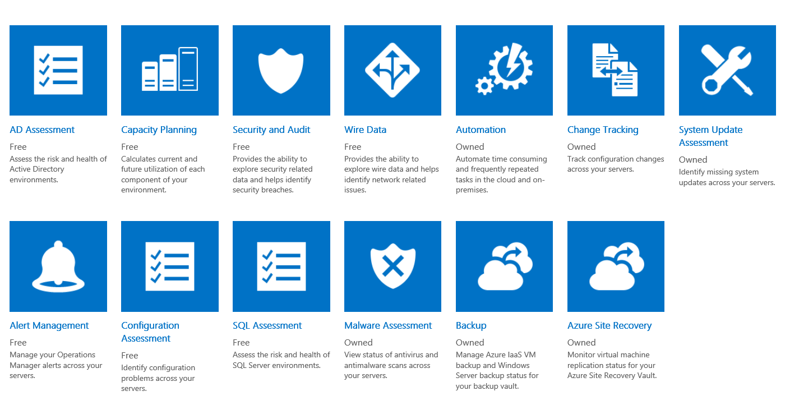
Solutions Gallery
Notes:
The Solutions Gallery is a growing list of solutions designed to help customers address common scenarios. They are currently all built by Microsoft and free to use, but

Slide 15
Custom dashboards
Pin commonly used search queries and reports to your dashboard for a tailored experience that saves time and enhances focus
Notes:
https://azure.microsoft.com/en-us/documentation/articles/operational-insights-use-dashboards/

Slide 16
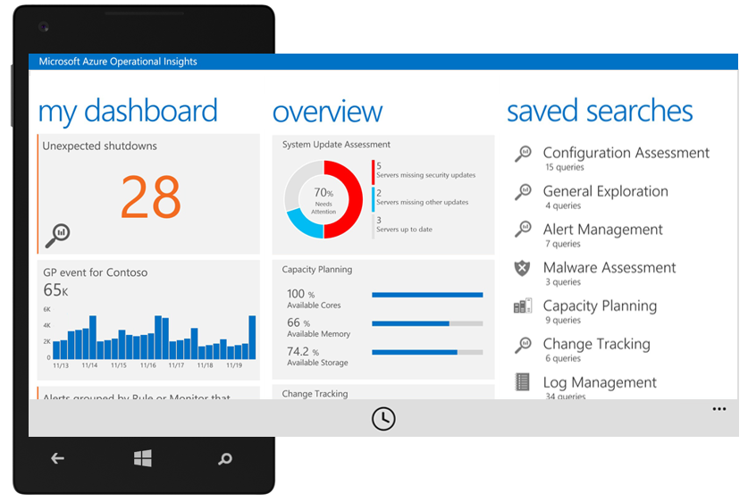
Monitoring on the go
Notes:
iOS and Android coming soon
TODO: Add to the diagram off the cloud service (collapse this slide into earlier diagram slide)

Slide 17
Understanding applications from the inside out

Slide 18
Understanding your users
Am I meeting my service KPIs?
Is my application crashing?
How many people are impacted?
What is the root cause?
Is my application loading fast enough?
What exactly was going on?
How responsive are my dependency calls?
Is my application UP or DOWN?
Is my server able to handle the load?

Slide 19
Application Insights
Consolidated analytics across server and client
Analyzes usage patterns
Detect, triage, and diagnose performance issues
Support for mobile and web applications
Built-in tooling for a variety of IDE’s and frameworks
Notes:
Built-in Analytics - Fully integrated with development tools across multiple platforms
Deep Insights - Explore and analyze across dimensions to make informed prioritization decisions
360° View - 360° view of your app with availability, performance and user behavior

Slide 20
Sources of telemetry data
Outside-in monitoring
1
URL pings and web tests from 16 global points of presence
Observed application behavior
4
No coding required – service dependencies, queries, response time, exceptions, logs, etc.
Observed user behavior
2
Real user monitoring for deeper diagnostic insights
5
Infrastructure performance
System performance counters
Developer traces and events
3
Whatever the developer would like to send to Application Insights

Slide 21
End to end telemetry with Application Insights

Slide 22


Managing data flow
Application
Insights
Application
Adaptive Sampling
Fixed-Rate Sampling
Filtering
Application
Ingestion
Sampling
Application
Notes:
Sampling is the recommended way to reduce traffic while preserving accurate statistics. The filter selects items that are related so that you can navigate between items in diagnosis. Event counts are adjusted in metric explorer to compensate for the filtered items.
Adaptive sampling is recommended. It automatically adjusts the sampling percentage to achieve a specific volume of requests. Currently available for ASP.NET server-side telemetry only.
Fixed-rate sampling is also available. You specify the sampling percentage. Available for ASP.NET web app code and JavaScript web pages. The client and server will synchronize their sampling so that, in Search, you can navigate between related page views and requests.
Ingestion sampling operates as the telemetry is received at the Application Insights portal, and so it can be used no matter what SDK you're using. It doesn't reduce telemetry traffic on the network, but it reduces the volume processed and stored in Application Insights. Only the retained telemetry counts in your monthly quota.
Per https://azure.microsoft.com/en-us/documentation/articles/app-insights-api-filtering-sampling/#sampling

Slide 23






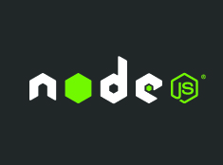


Supported Platforms & Languages
Any Platform - Any App
On-Prem, Azure, AWS, Google Cloud, App Stores
Open Source SDKs https://github.com/Microsoft/ApplicationInsights-Home
Logging Frameworks Log4Net, nLog, System.Diagnostics, Log4J, Logback
Notes:
Application Insights offers SDKs for a variety of programming languages, all available on GitHub.
Also, if you currently collect log data from services such as Log4Net, nLog, etc. you can send that data into App Insights for integration with data from other sources.
https://azure.microsoft.com/en-us/documentation/articles/app-insights-asp-net-trace-logs/

Slide 24
Agenda
Out of the box service monitoring capabilities
Monitoring environments
Understanding application usage
Notes:
This session has shown a variety of methods of obtaining quantitative data on the Azure platform for use in monitoring and diagnostic scenarios. First we discussed the out of the box, built in metrics capabilities of the platform, including the ability to set alerts and monitor event logs. Next, we discussed deep analysis virtual machines regardless of Windows or Linux, Azure or AWS, or cloud or on-prem with Operational Insights. Finally we jumped into applications with Application Insights to get a complete view from both the server and client as to our application health and performance.

